Slide 1

Ammo Can Repeater
how I crammed
a VHF repeater inside
.50 Cal Ammo Can
Doug – NO1D
YARC Talk 20170302

Slide 2
Agenda
Bit of history of this project
Evaluation phase
Packaging options for portable repeaters
Meeting w/ Randy W6TYV at Jeep Posse Bld.
Construction
Results / Lessons Learned

Slide 3
Jeep Posse VHF Portable Repeater
First approached by Bud N7CW and John K7PRS
Evaluate a Portable VHF repeater (150Mhz)
Repeater was not working
Was it worth repairing
John delivers me a treasure chest full of VHF goodness
Always willing to help out the JP Team

Slide 4
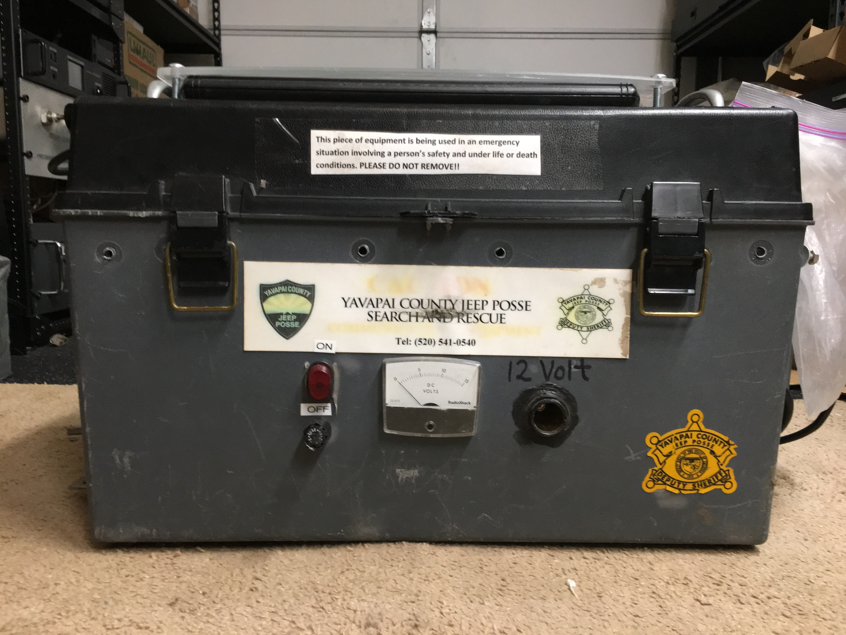

Slide 5
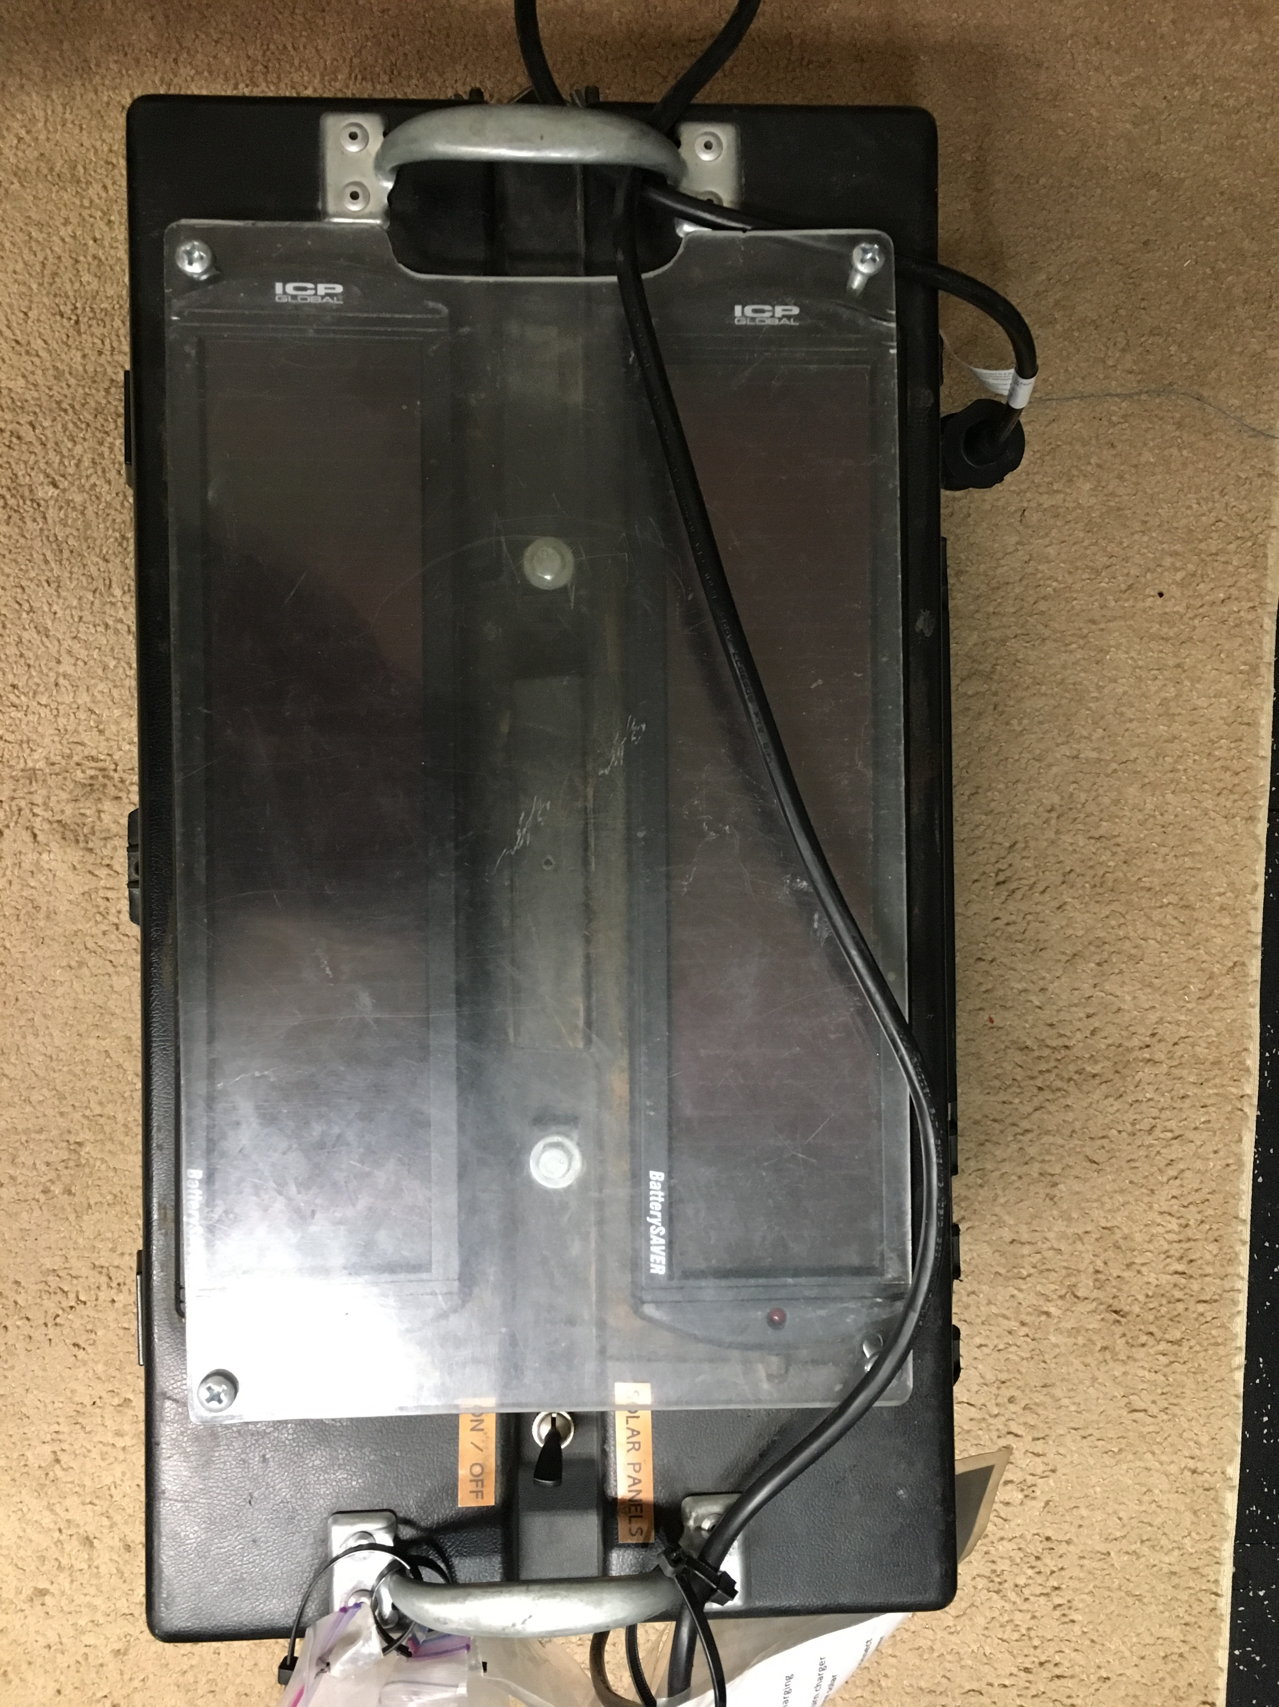

Slide 6
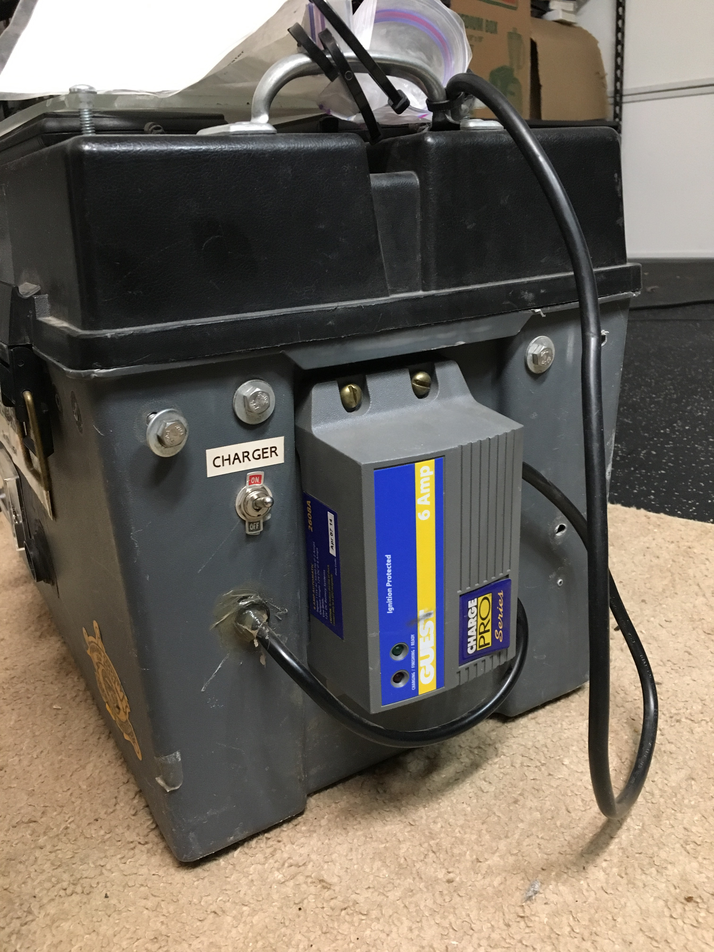

Slide 7
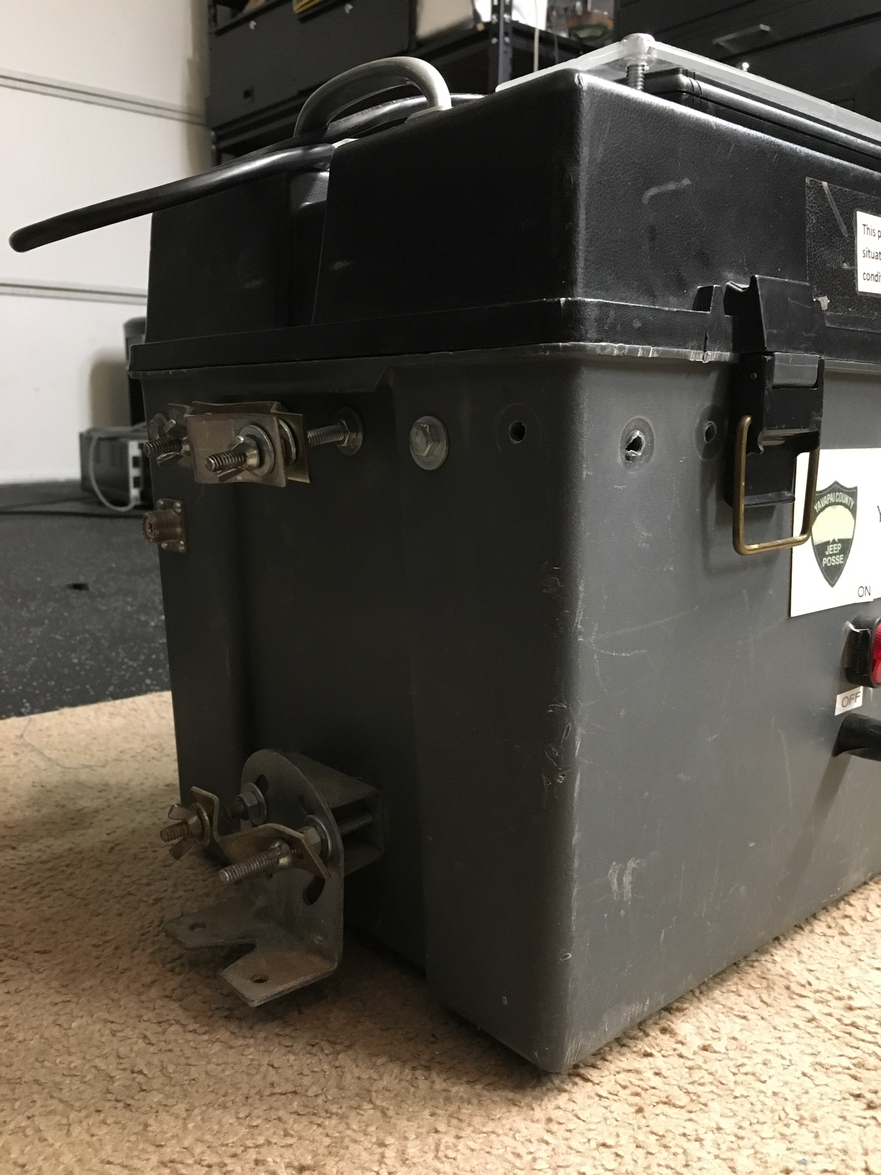

Slide 8
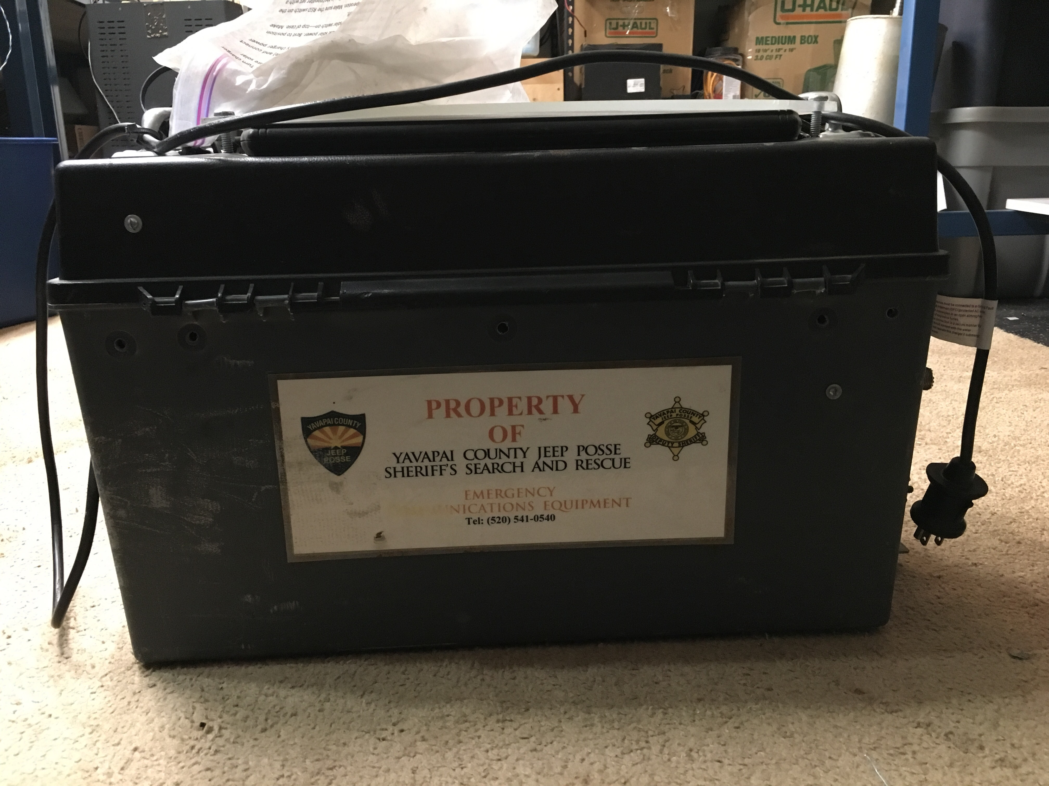

Slide 9
Evaluation
Plastic Toolbox was used for packaging
Batteries, Lead Acid, loose in box, not great deal of protection against shorts
Solar Power Panels... neat, but trickle charge of batteries at best
Small Mobile Duplexer, bit beat up but tunable
Two nice Kenwood high band rigs; working
CES Repeater Maker controller, velcro’d in place
Repeater Controller does not ID... FCC Compliance issue
Wiring left something to be desired
Packaging did not look like would survive bouncing around in a Jeep in back country...

Slide 10
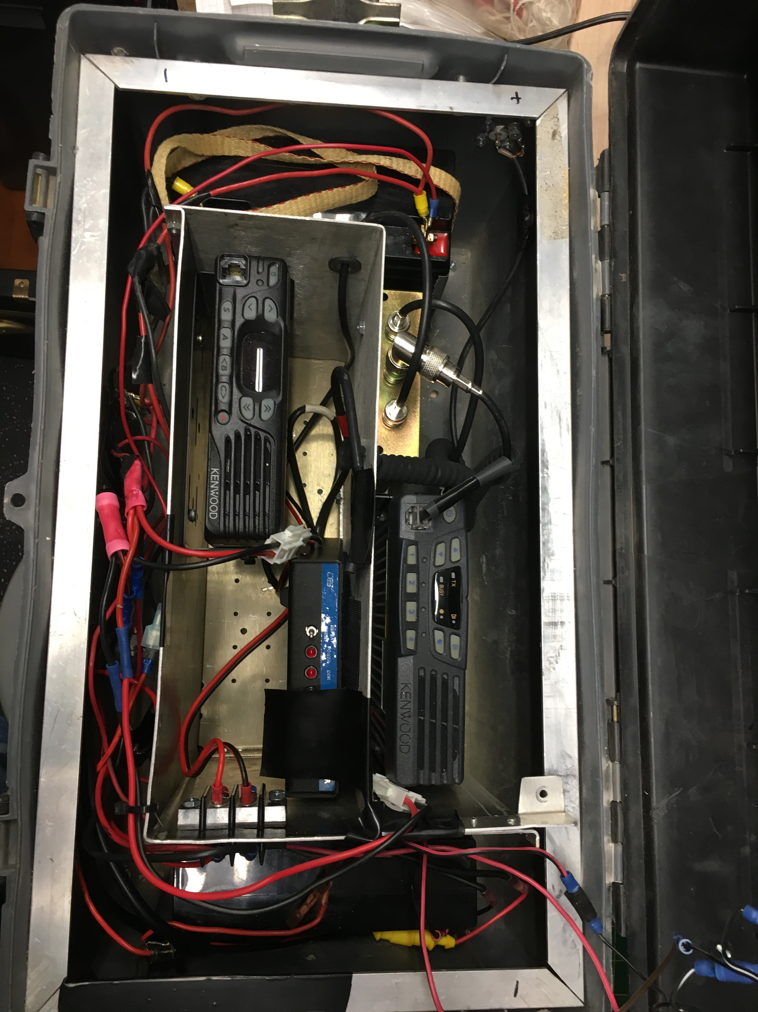

Slide 11
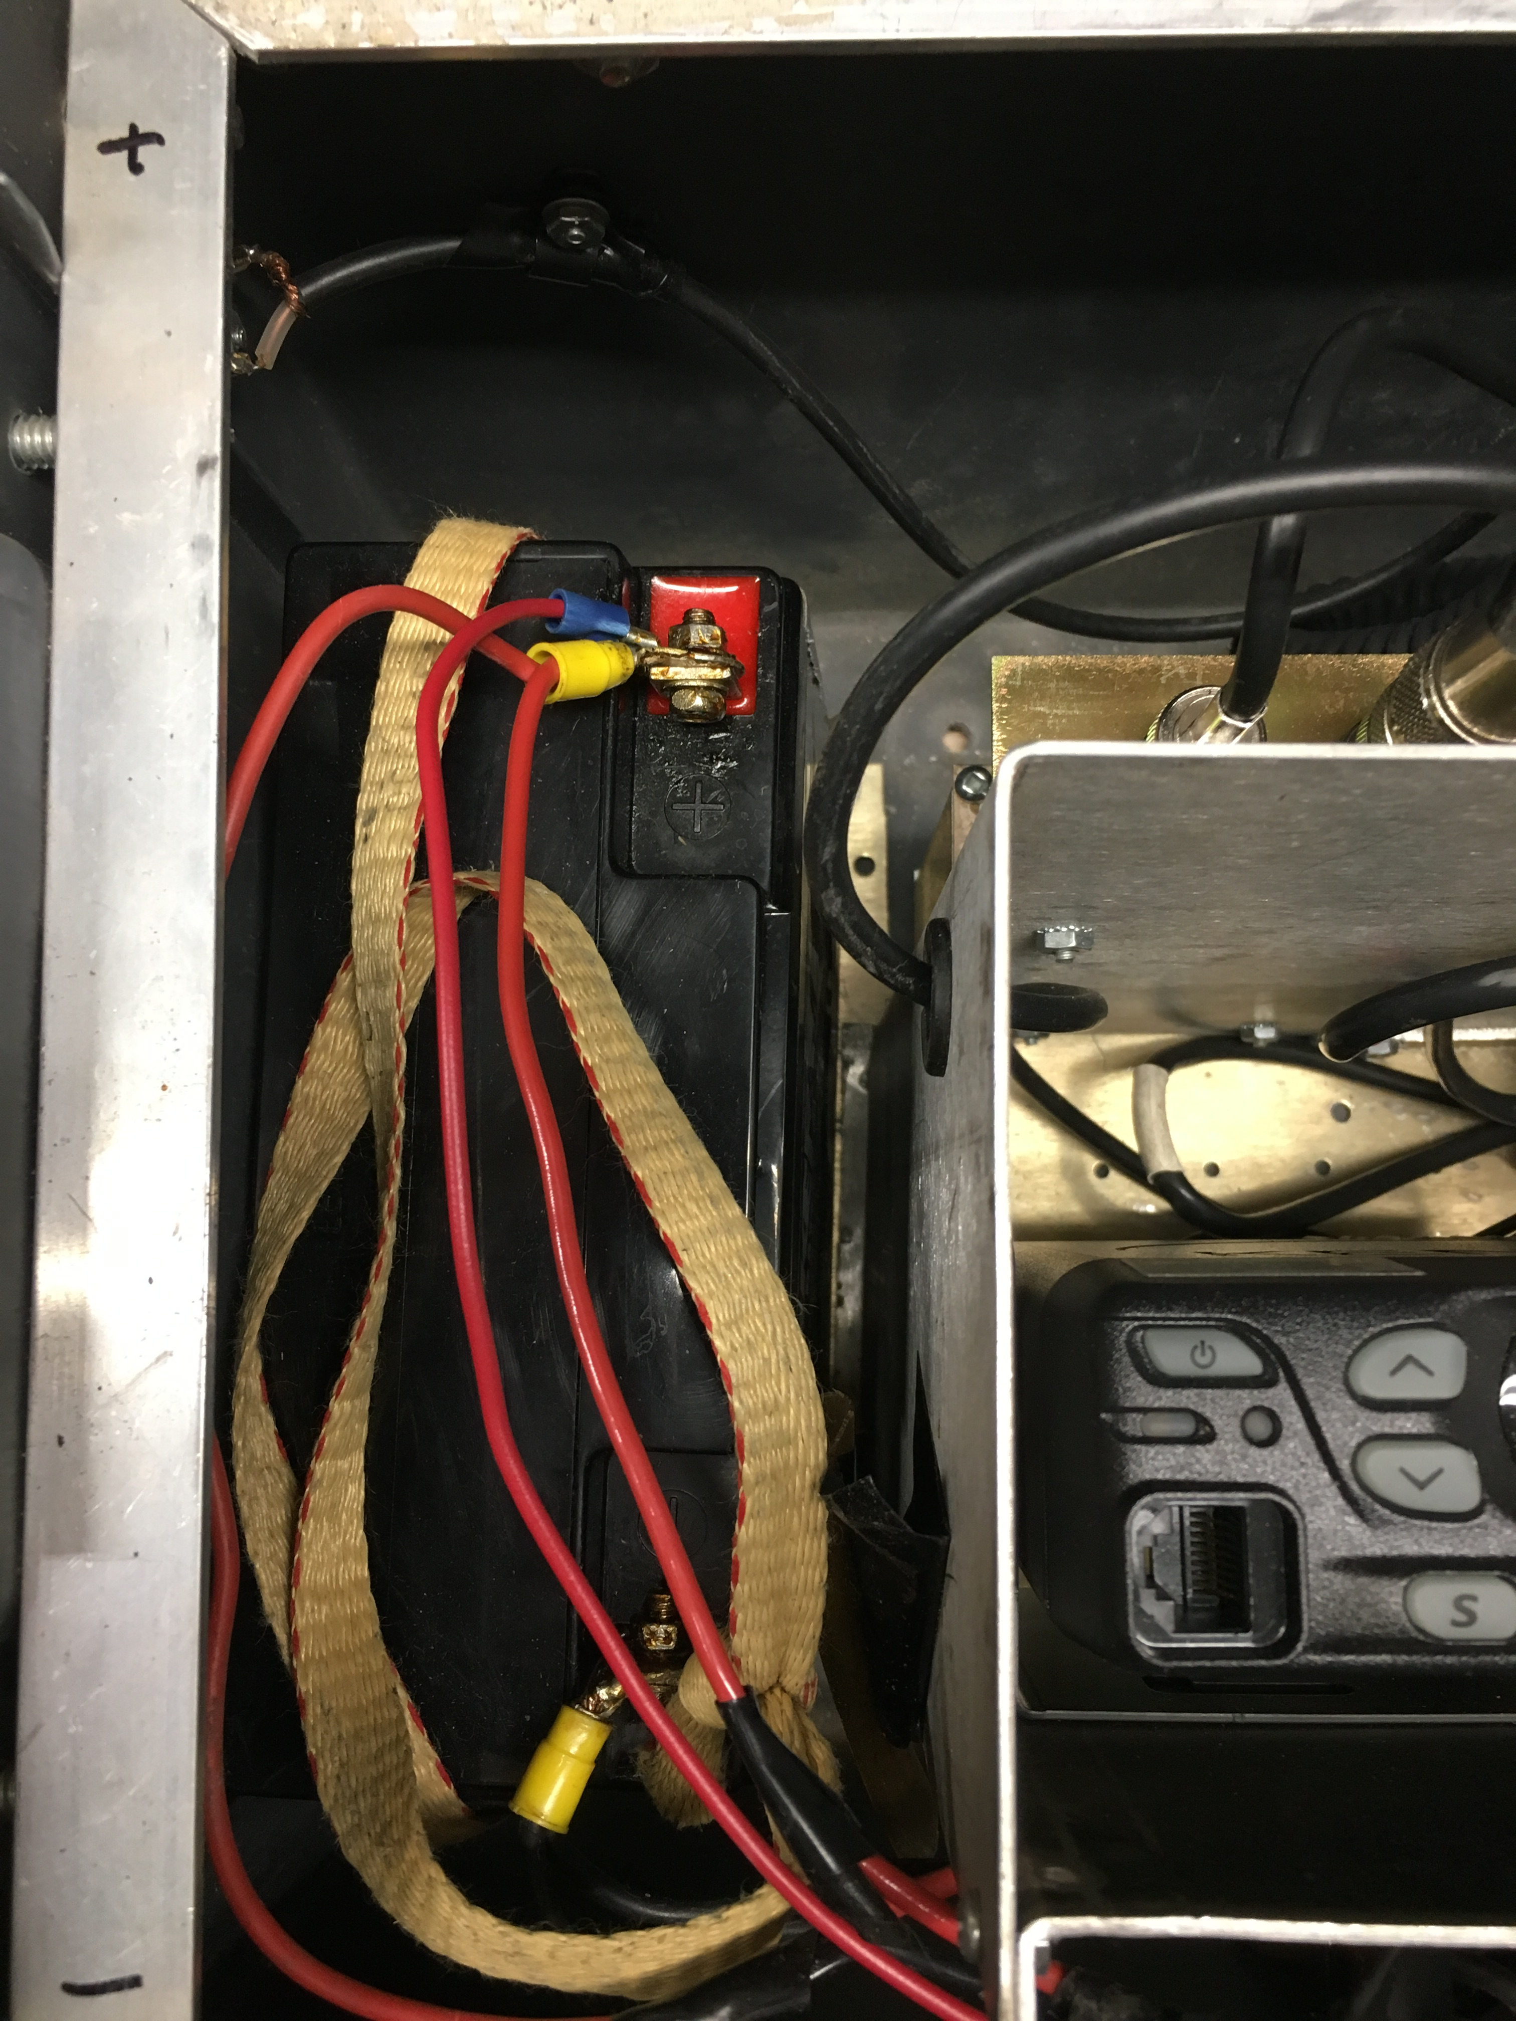

Slide 12
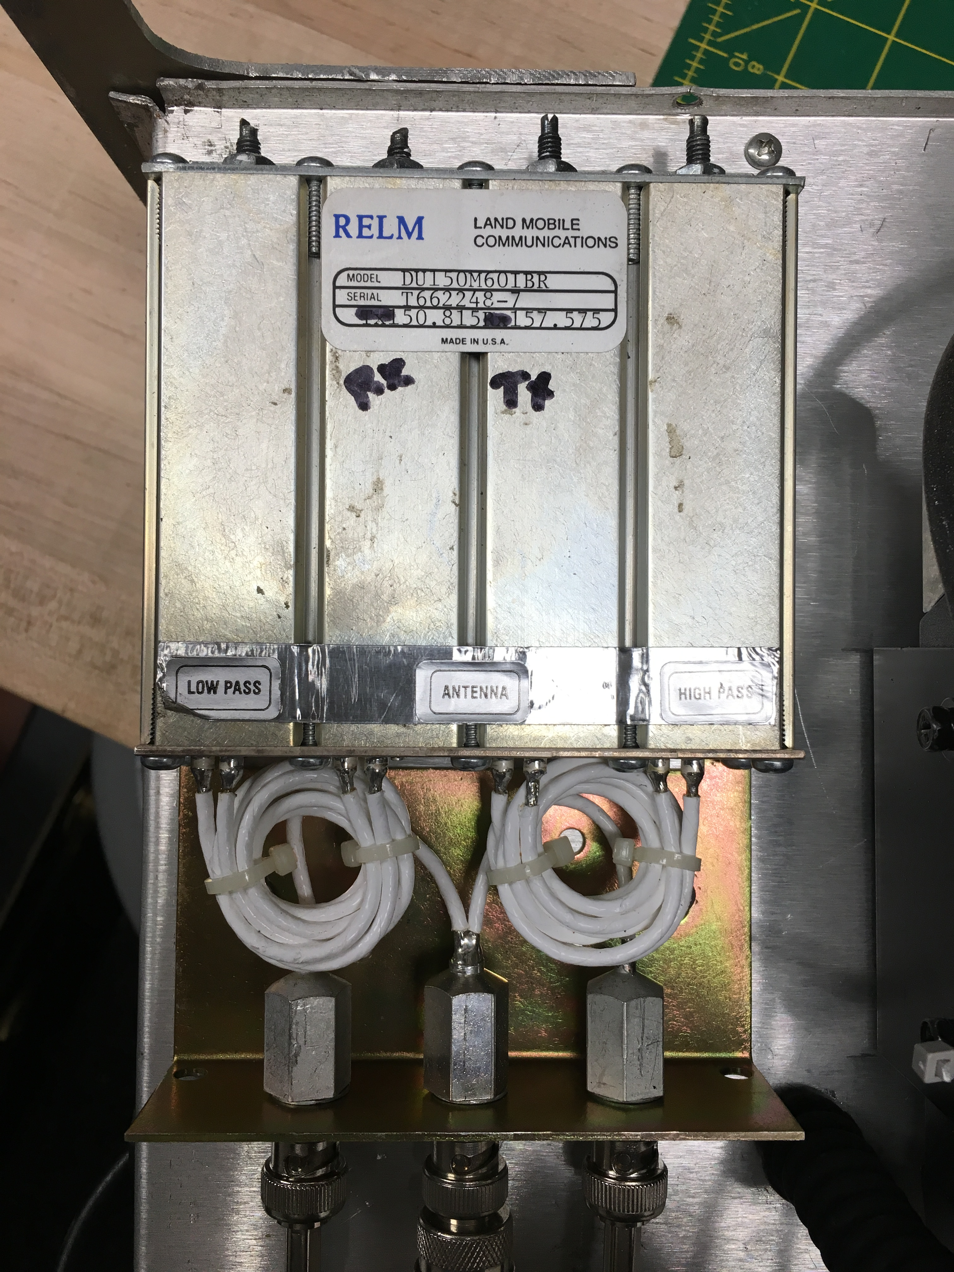

Slide 13
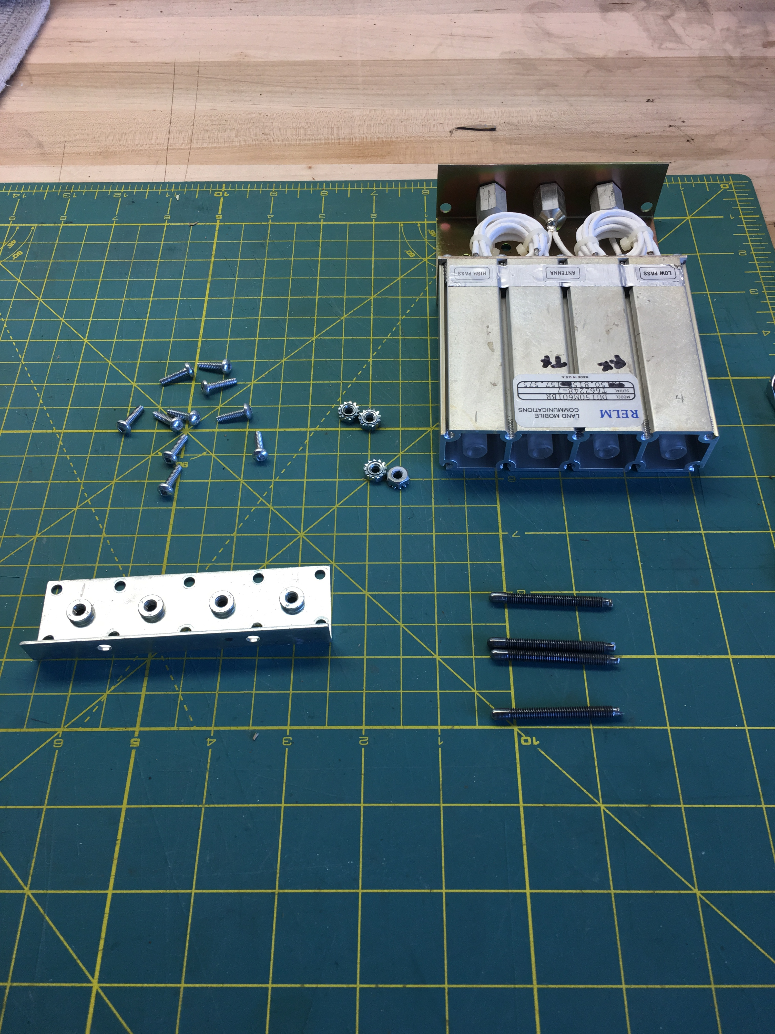

Slide 14
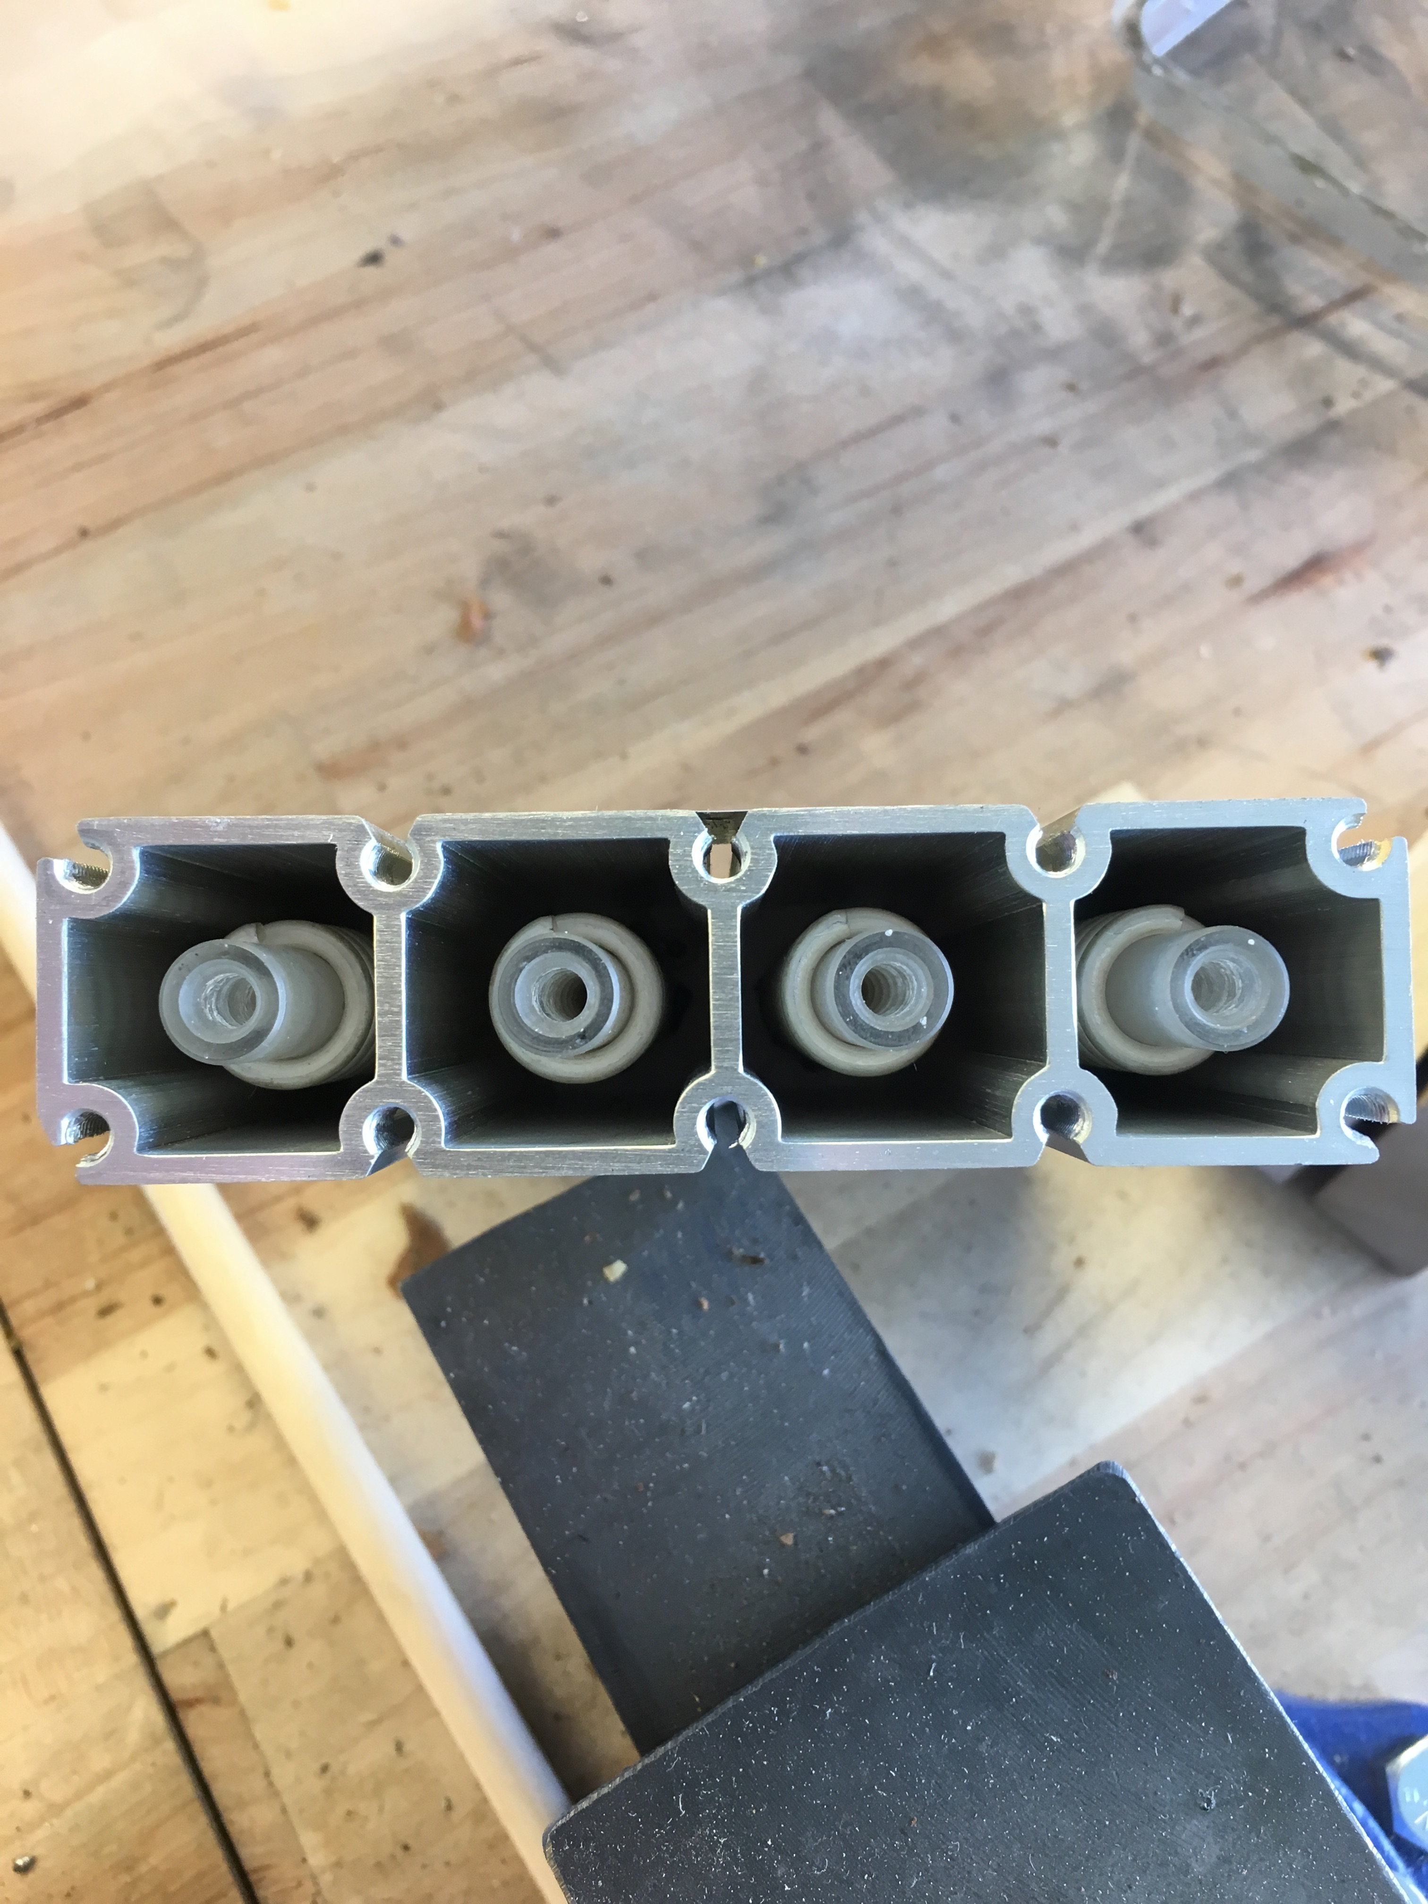

Slide 15
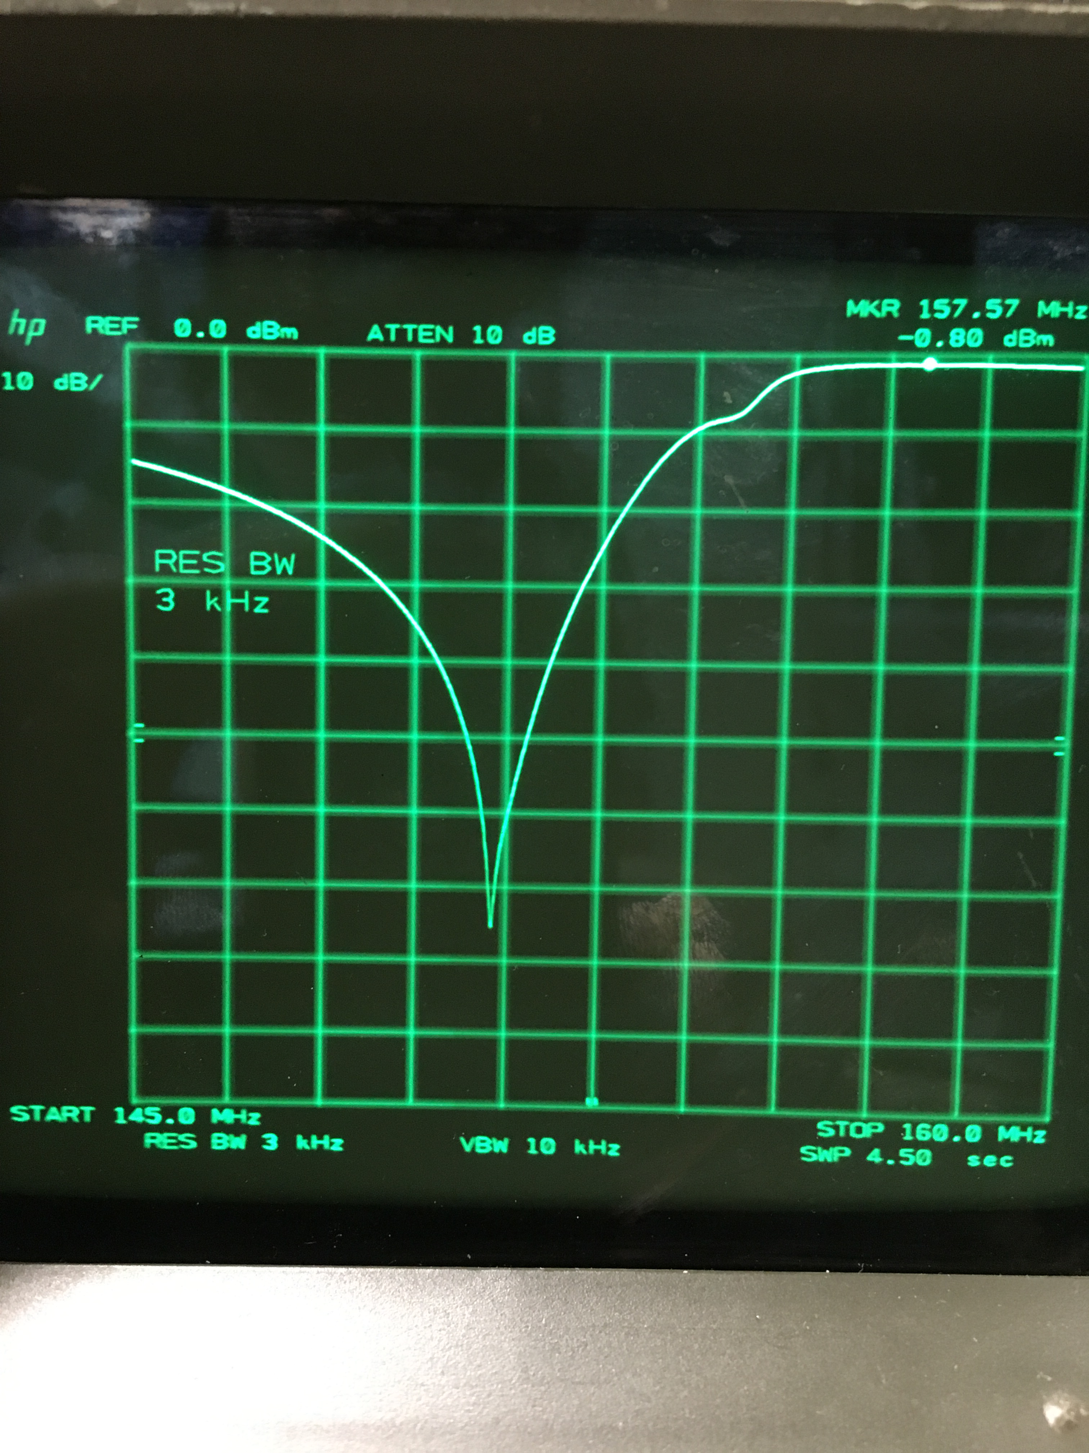
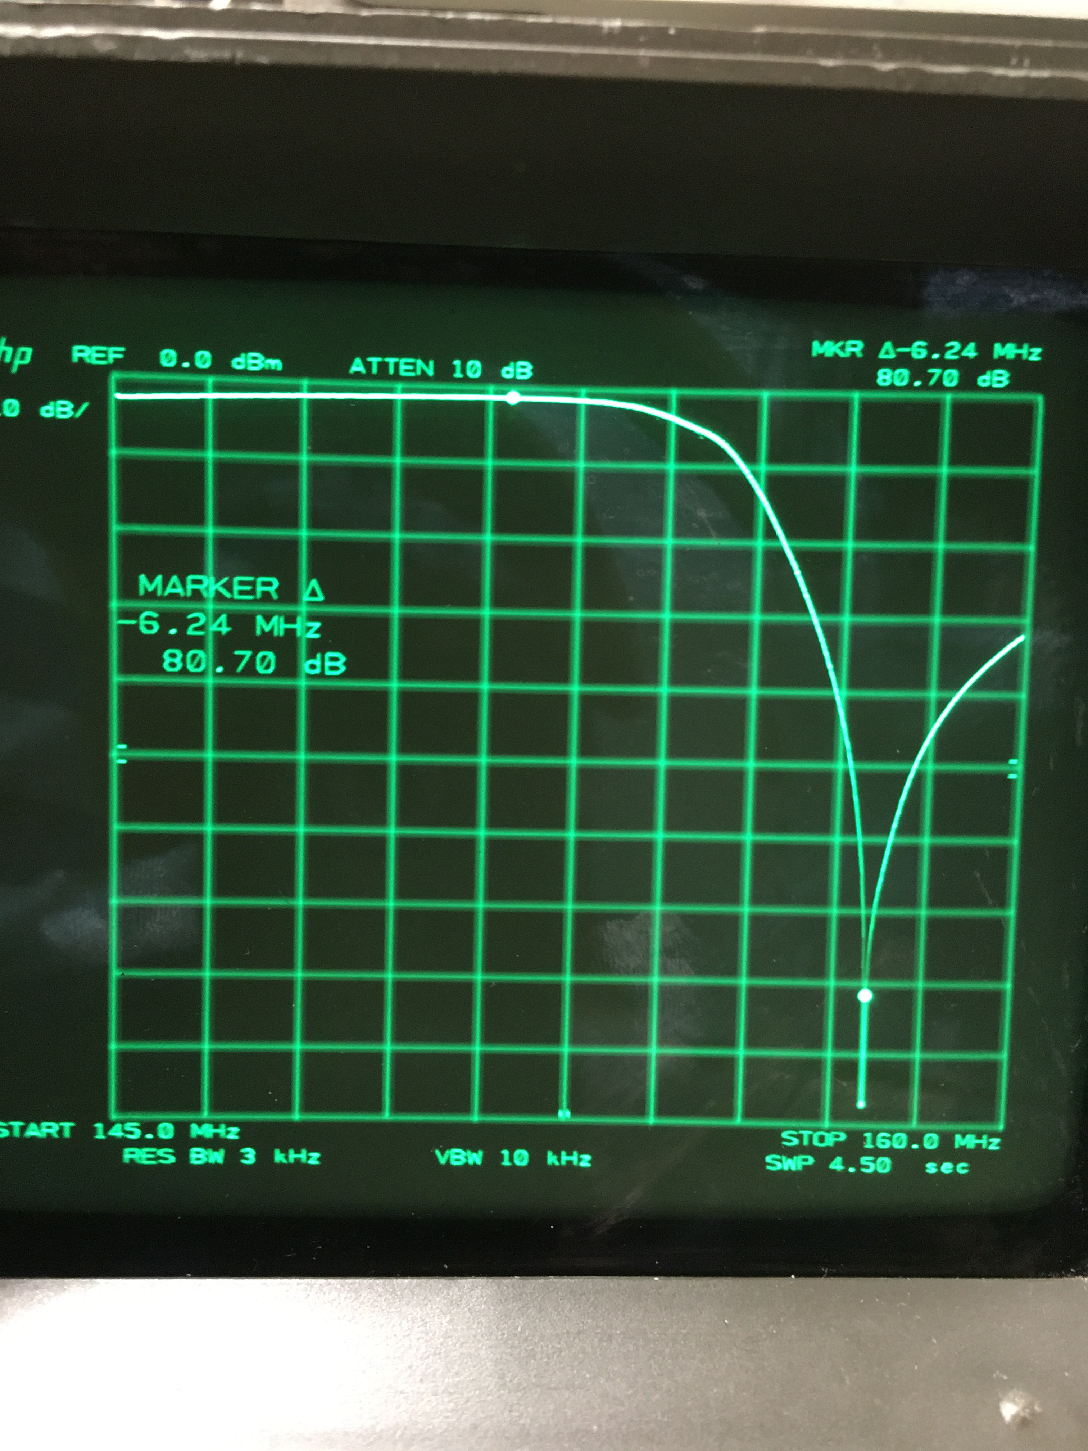

Slide 16
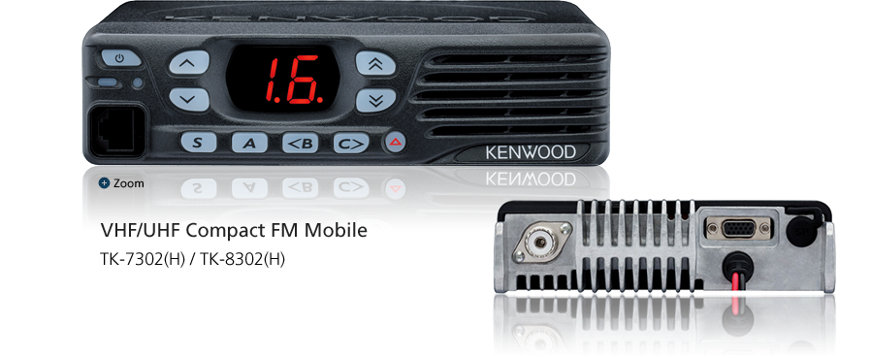
Type Compliance Check
First had to read up on FCC Rules for commercial and Public Safety gear; recent change for narrow band
12.5Khz deviation with 6.25Khz futures
Ham gear is 15Khz BW max but some rigs are using narrow band 11-12Khz
Kenwood Rigs identified as narrow band per todays rules
TK7301(H)
Narrow banding allows more “channels” per spectrum allocation.

Slide 17
Packaging Options
Flight Line 19” cases
Very nice options, DJ cases, Test Eq. transports
Amazon has some good pricing
Great idea if using full size duplexer's
Boat Anchor Chassis
Old Collins Spec An chassis from K7PRS
Wooden
But I’m horrible at wood working
Ammo Cans
Many size options
Waterproof, solid clasp mechanism, carrying handle
Built to survive war !

Slide 18
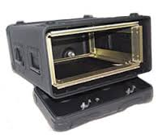
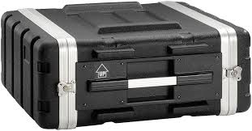
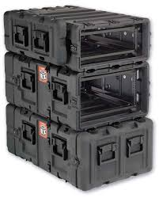
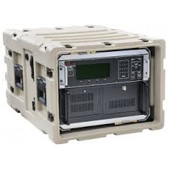

Slide 19
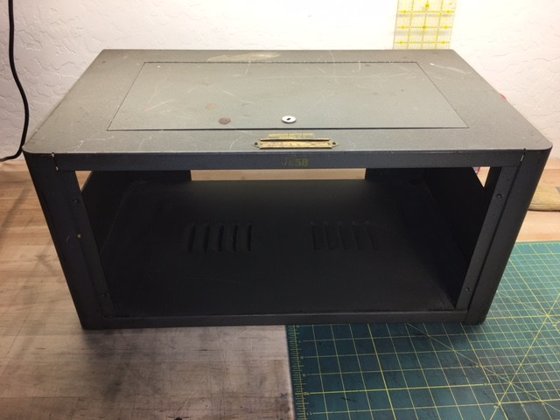

Slide 20
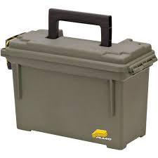
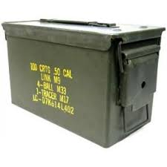
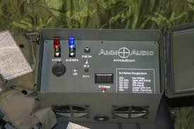
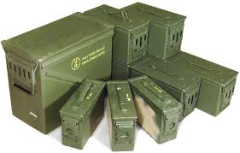

Slide 21
Meeting w/ Randy W6TYV
Discussed use of Portable Repeater with Fire Team
Unit never really worked if at all
Max coverage should be about 5 to 10 miles max
Deployed with someone w/ vehicle so power readily available.
Would like in place before Fire Season
Discussed Flight Line case options, but settled on goal to try and fit in an Ammo Can
Separate battery box or run from Jeep battery
No solar panels, charger box, 110v. Keep it simple; 12v Repeater
Reprogrammed Tx rig to run from 50W to 20W.
Found that Tx freq on JP rigs may be mis-programmed
150.851 Mhz vs 150.815 Mhz on spread-sheet

Slide 22
Construction
Rough dry fit of rigs, duplexer and controller
Normal .50 Cal can too small, but Fat .50 can was just right; 1” to 2” more in each dimension
Paper sketched up front panel layout
Didn’t want to drill many if any holes at all in Ammo Can to preserve water proofing
Decided on slide in chassis w/ minimal screws thru can
Front panel would need to supply air in/out to help keep rigs cool or at least not overheat
Re-used angle stock, sheet metal from the old case

Slide 23
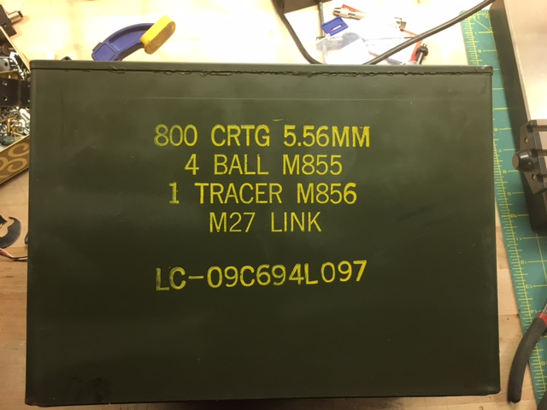

Slide 24
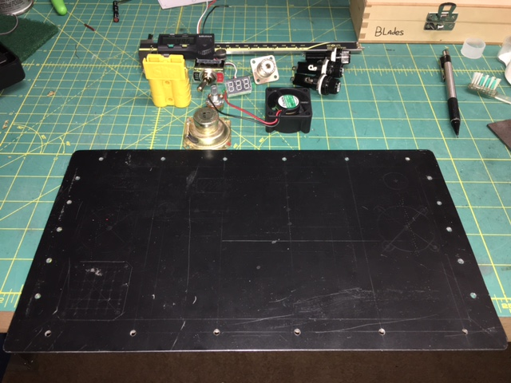

Slide 25
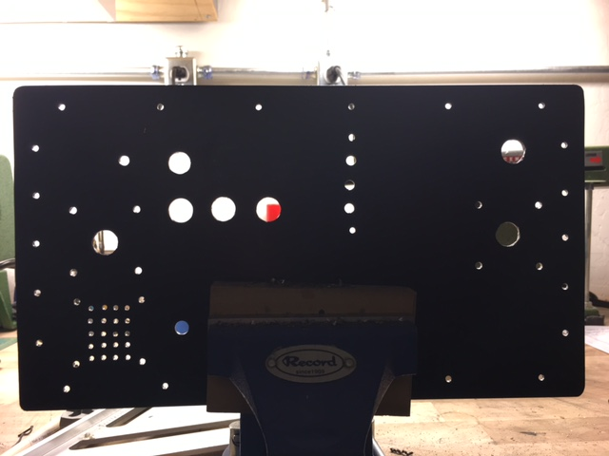

Slide 26
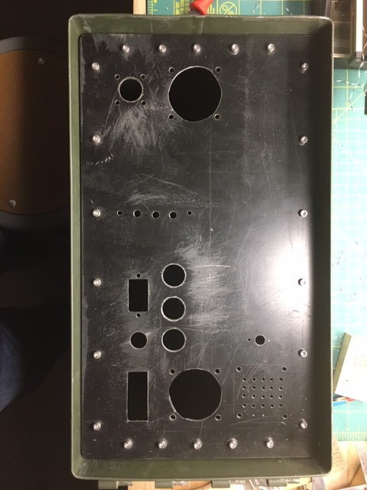

Slide 27
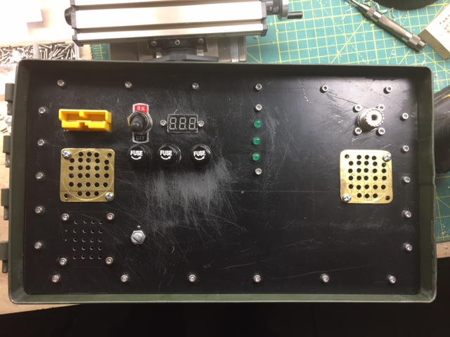

Slide 28
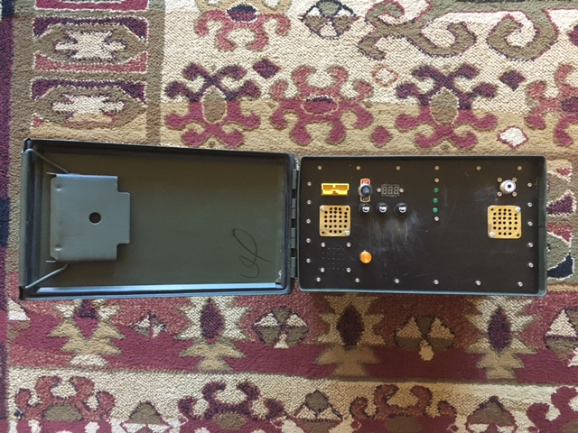

Slide 29
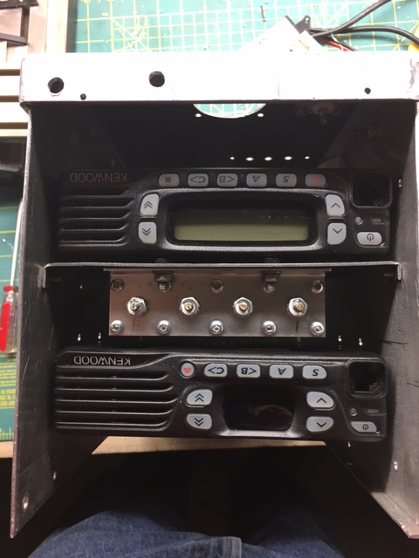
Slide in chassis allows for servicing and reprogramming of rigs without removal
And allows for periodic duplexer tuning

Slide 30
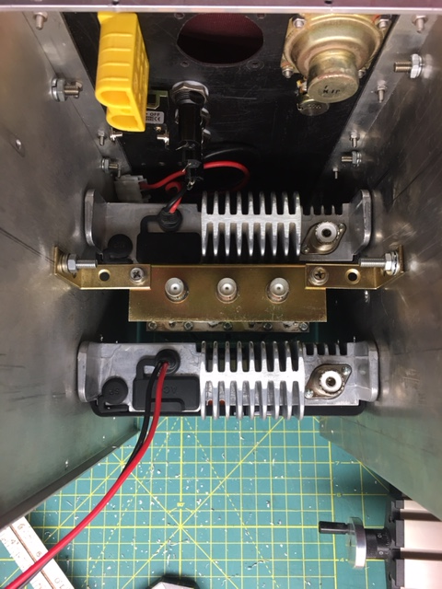
Rigs fit perfectly in width of can
TX nearest front panel for cooling
Re-used old brackets or made new ones from scrap

Slide 31
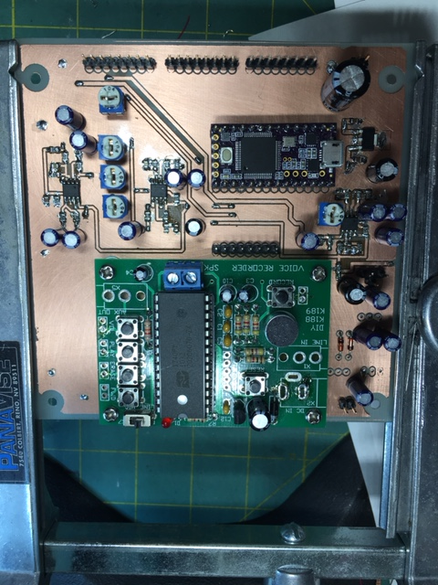
Teensy 3.2 Repeater Controller
Leveraging work from the Westel Repeater project for Sherwin WB7NFX
CW ID every 30m when repeater is active per public safety rules

Slide 32
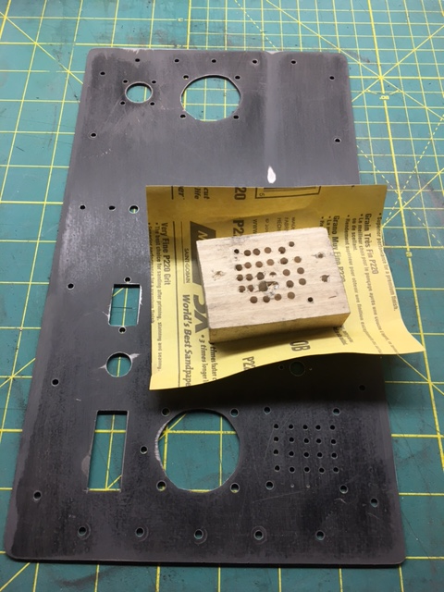
Prepping the Panel... sanding up to 800 grit

Slide 33
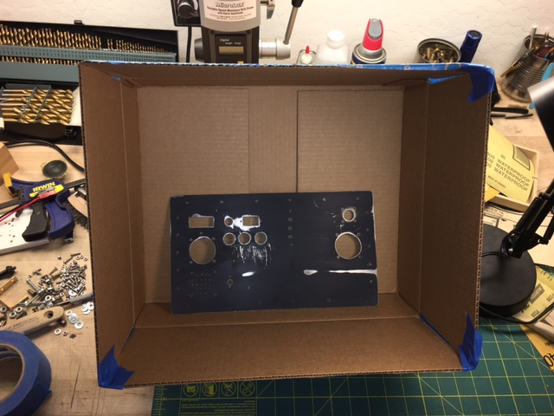
Spray Box using cardboard box

Slide 34
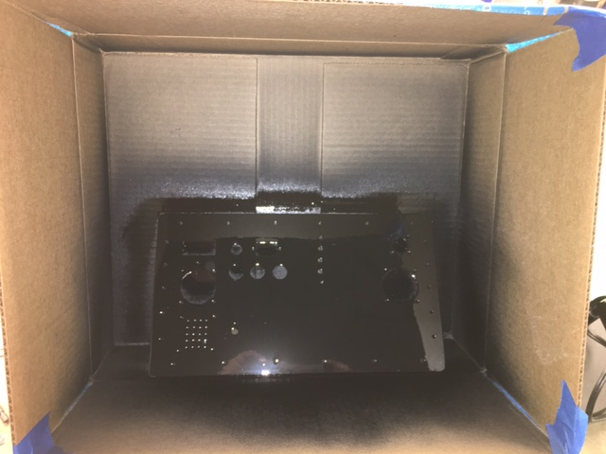
Gloss... But I bought Flat - Ugghh

Slide 35
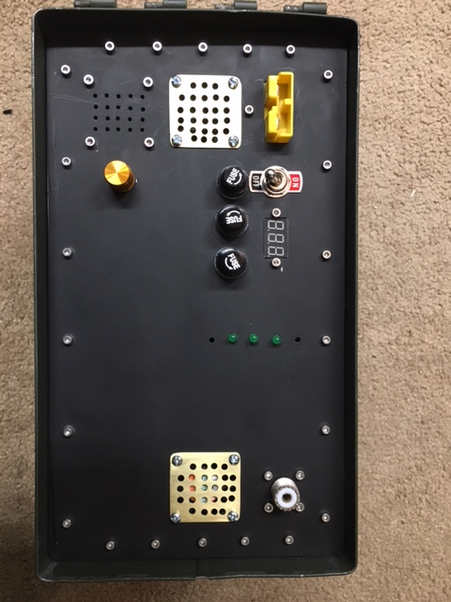

Slide 36
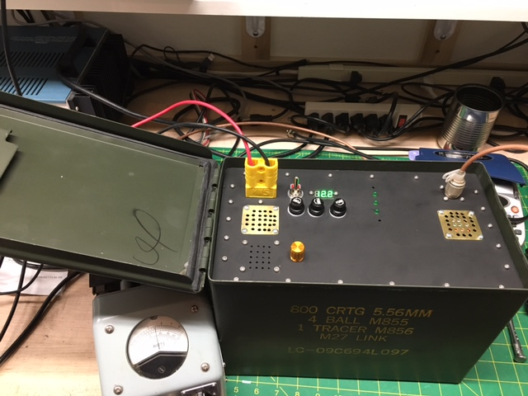

Slide 37
Remaining Work
Add Teensy Repeater ID Timer Board
Power Cable to Jeep
RX PLL Check – Possible Reprogramming
Clean up and secure internal wiring
LEDs for Controller/Timer Board
Front Panel Lettering – License Info
Recommendation on Antenna/Mast/Base
Range/Field Test

Slide 38
Lessons Learned
My metal fabrication techniques need a lot of work
Cutting 1/8” steel plate with scroll saw takes time
John those Greenlee Punches would have been great !
Harbor Freight drill bits break/bend easily with hand drills
Try not to drag metal fillings from the lab to the kitchen... or you’ll hear about it when one sticks into your wifes foot
Screw hole alignments... did I say metal work was hard !
Painting... wanted flat, somehow can was gloss ?
Still don’t know what went wrong here

Slide 39
Finale’
Fun project
As many complaints I had, was still fun to build
Hope it works well for our friends at the JP who are doing great work, especially during Fire Season
Ammo Cans are a good base to build with
Battery Box – spare batteries for your GoBox
Go Box – HF or VHF/UHF portable rigs
Tool box for Field Day; antenna gear, connectors etc.
or prepping for the “Zombie Apocalypse”
Need to package gear... consider an old Ammo Can

